Slide 1
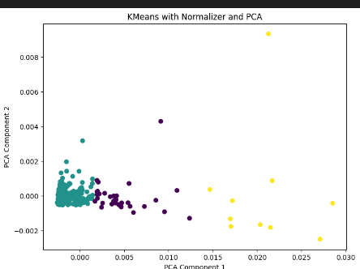

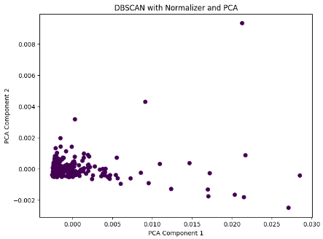
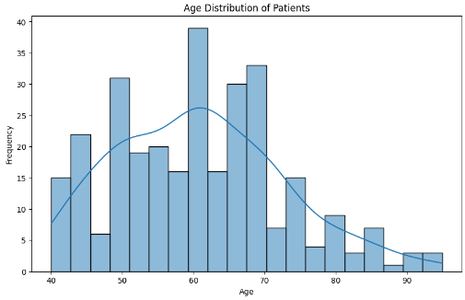
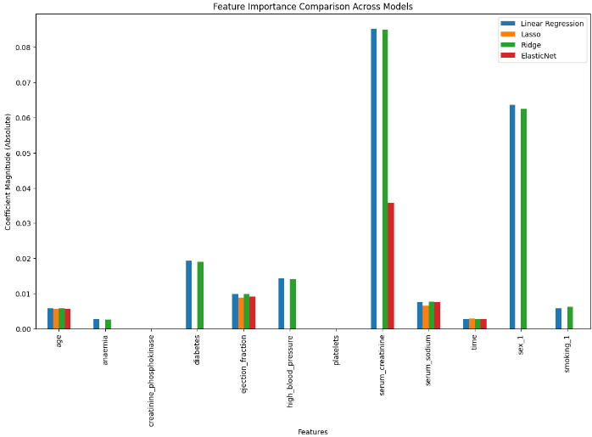
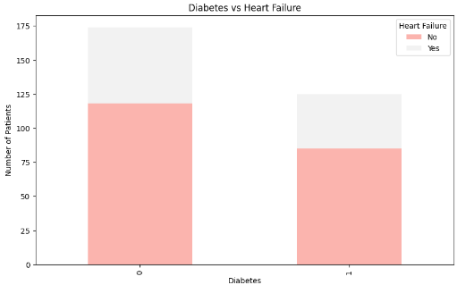
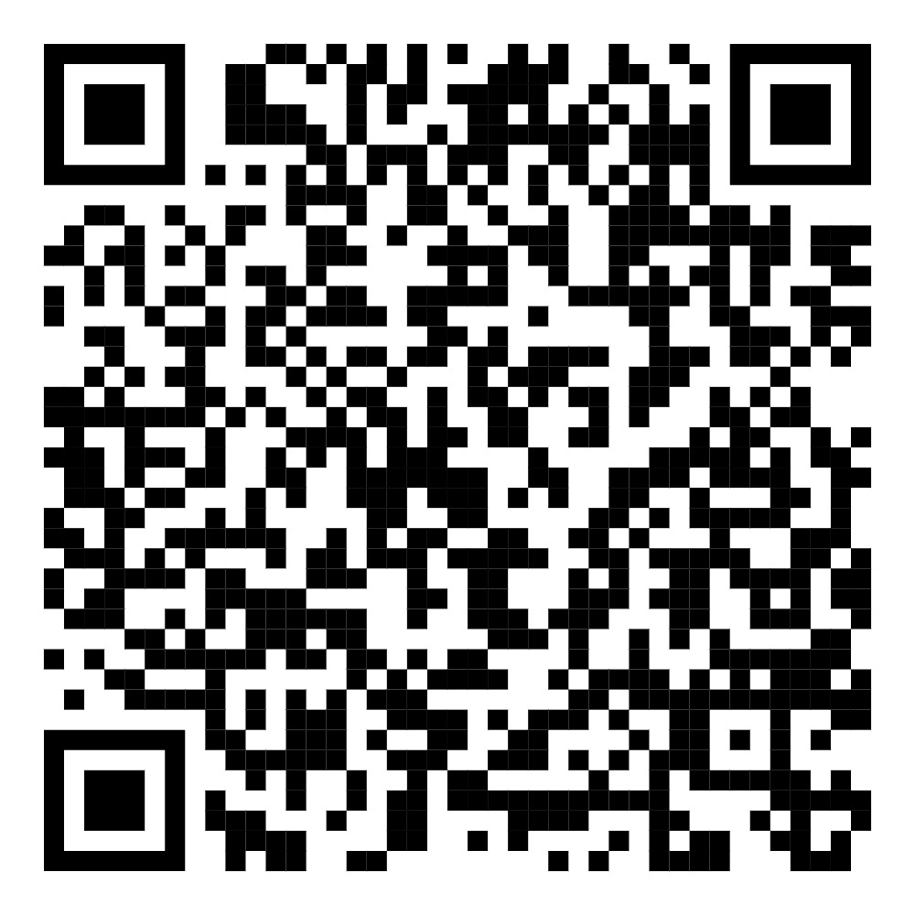
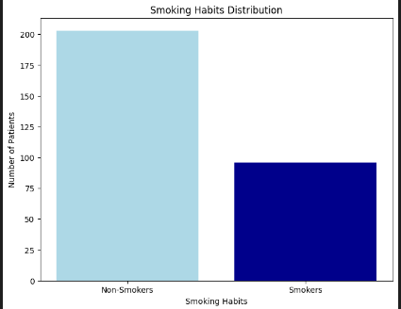
Serum creatinine, ejection fraction and time are key predictors of heart failure.
Non-Cognitive Predictors of Student Success: A Predictive Validity Comparison Between Domestic and International Students
Non-Cognitive Predictors of Student Success: A Predictive Validity Comparison Between Domestic and International Students
Heart Failure Analysis
Additional Graphs:
Ahfaz Abdul, Sai Sushama Nimmagadda, Harish Babu Ramineni
INTRO
This Project analyzes the Heart Failure Clinical Records to identify key predictors and trends using visualization, clustering and feature analysis for better patient management.
METHODS:
Data : Analyzed 299 heart failure patients, including 13 features such as age, serum creatinine, ejection fraction and time along with demographic, lifestyle and medical data.
Testing :
Clustering Algorithms: Applying Kmeans, Agglomerative Clustering and DBSCAN to identify patterns and ourliers.
Regression Analysis: Applied OLS, Linear, Lasso, Ridge, ElasticNet regression with 5-fold cross-validation to predict outcomes and identify key predictors.
EDA: Used line plots, scatter plots, pie charts, bar plots and heatmaps to analyze feature distributions and relationships.
RESULTS:
DISCUSSIONS:
Key Predictors: Serum creatinine, ejection fraction and time are critical for early detection and targeted interventions.
Clustering Insights: K-means identified patient groups, and DBSCAN highlight outliers for unique cases.
Visualization Highlights: Age significantly impacts outcomes, while smoking and diabetes play secondary roles.
Scan to explore the analysis.
Notes:
Notes:
In Powerpoint, click View > Guides
Keep text within gutter guides.
Author list: Don’t split names onto two lines (e.g., “Jimmy [break] Smith”). If that happens, use a new line, unless you need the space. Bold the first names of anybody who’s presenting in person.
Intro/methods/result: Do not drop below font size 28, but if you have extra space, jack up the font size until the space is full.
Do not use color in the sidebars except in graphs/figures. It’ll pull attention from the center and slow interpretation for passersby.

